Slide 1

Data Science for Case Law
Group 45:
Gufran pathan prerna Aggarwal Fernando medeiros

Slide 2
Problem Statement
Headnotes are brief case summary statements for court cases. They are generated by commercial third parties. They are usually under copyright protection and may not be available or may be subject to usage restrictions. In this project we will use NLP summarized algorithms to reconstruct headnotes using a variety of court cases as our training dataset. We have used for training, the dataset for historical court cases provided by the CaseLaw Access Project. We have selected cases for the state of North Carolina from the Harvard Law School Library

Slide 3
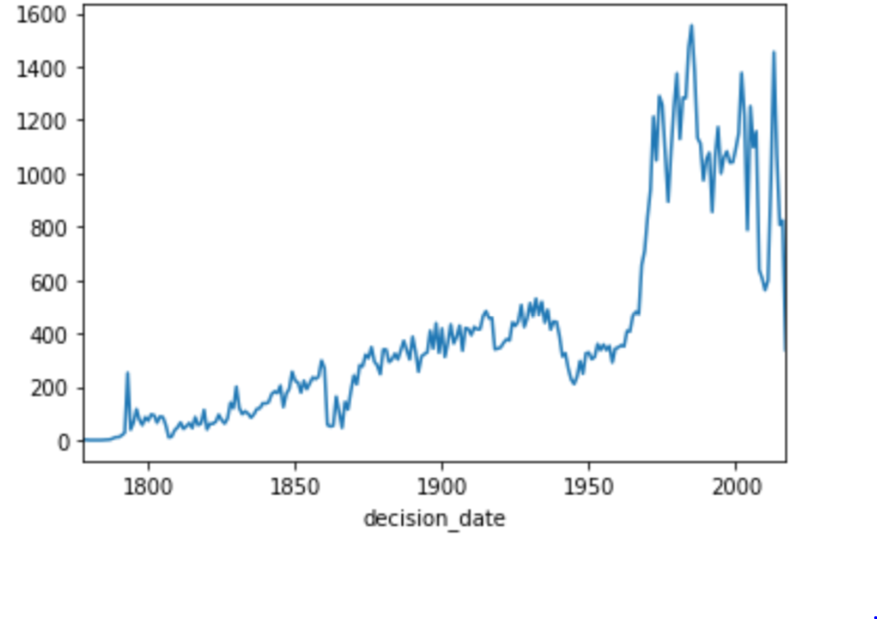
Exploratory Data Analysis
Data: We are using the dataset provided by the CaseLaw Access Project. We have selected cases for the state of North Carolina from the Harvard Law School Library.
Data Format | json
Number of Cases | 97600 (using 3,693 cases)
Number of Columns | 32
Relevant Columns | casebody.data
casbody.data structure | xml
Relevant casebody columns | headnotes and opinion
Number of cases by year

Slide 4
Preparing the data
The steps to prepare the data for our models:
Selected cases since 2008
Extract majority opinion and headnotes from casebody.data
Removed ‘\n’ from the opinions
Save data where length of headnotes > 150 and opinion is larger than the headnotes
Tokenize the headnotes and opinions
Preprocess using Bert preprocessor to label opinions.
Split data into training testing and validation sets

Slide 5
Steps for labeling data
The steps to prepare the data for our models:
For each sentence in opinion and compare it to the sentences in the headnotes.
If the sentence increases the rouge score, select the sentence for the summary.
Label the tokenized opinion so that the sentences that are selected have a label of 1 and the sentence that is not selected has a label of 0
Additional columns created are for each opinion
The starting index of each sentence
The rank of each word in an opinion

Slide 6
Our Research
We searched for existing models that generate summaries based on the following criteria
Generate Extractive summaries since they can generate semantically and grammatically correct sentences these models need less resources and understanding of the domain.
Summarize long documents
Perform well as measured by the ROGUE (Recall-Oriented Understudy for Gisting Evaluation) Metric Score.
Can be implemented in the given time constraint

Slide 7
Types of Summarizations
Extraction-based summarization: Content is extracted from original document and is not modified. This method will extract key phrases or sentences to form a summary. The summary generated by this method may not be the same format as a human might express it and the sentences may appear disjointed
Abstraction-based summarization: Abstractive methods generate a summary based on internal semantic representation of the original content, closer to what a human might express. Abstraction may transform the extracted content. Such transformation are computationally very challenging , involving both NLP (natural language processing) and a deep understanding of the document

Slide 8
Our Research
The models we researched are
Text Summarization with Pretrained Encoders (PreSumm):
by Yang Liu and Mirella Lapata
The PreSumm model uses BERT for text summarization and propose a general framework for extractive models. This is a document-level encoder based on BERT which is able to express the semantics of a document and obtain representations for its sentences. Several inter sentence transformer layers are stacked over the BERT encoder.
Our extractive model is built on top of this encoder by stacking several inter- sentence Transformer layers to capture document- level features for extracting sentences. Our abstractive model adopts an encoder-decoder architecture, combining the same pre-trained BERT encoder with a randomly-initialized Transformer decoder.
Bidirectional Encoder Representations from Transformers (BERT; Devlin et al. 2019) represents a pretrained language models which have recently advanced a wide range of natural language processing tasks.
code is available at https://github.com/nlpyang/PreSumm

Slide 9
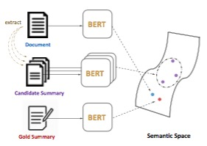
Our Research
Extractive Summarization as Text Matching:
By Ming Zhong, Pengfei Liu, Yiran Chen, Danqing Wang, Xipeng Qiu, and Xuanjing Huang
Most extractive summarization systems extract sentences one by one from the original text, model the relationship between the sentences , and then select several sentences to form a summary. and may not consider the semantics of the entire summary.
This method performs Semantic text matching to estimate semantic similarity between a source and a target text fragment. It is trained on the CNN/ Daily Mail dataset and uses a Siamese-BERT(Bidirectional Encoder Representations from Transformers) architecture to compute the similarity between several candidate summaries to the source document and select the best candidate summary.
A Siamese networks consists of two identical neural networks, each taking one of the two input inputs. The last layers of the two networks are then fed to a contrastive loss function , which calculates the similarity between the two inputs.
Siamese BERT leverages the pre-trained BERT in a Siamese network structure to derive semantically meaningful text embeddings that can be compared using cosine-similarity.
Code from https://github.com/maszhongming/MatchSum
Extractive Summarization as Text Matching

Slide 10
Our Research (DUPLICATE)
Extractive Summarization as Text Matching: Most extractive summarization systems extract sentences one by one from the original text, model the relationship between the sentences , and then select several sentences to form a summary. and may not consider the semantics of the entire summary.
This method performs Semantic text matching to estimate semantic similarity between a source and a target text fragment. It is trained on the CNN/ Daily Mail dataset and uses a Siamese-BERT(Bidirectional Encoder Representations from Transformers) architecture to compute the similarity between several candidate summaries to the source document and seledt the best candidate summary.
A Siamese networks consists of two identical neural networks, each taking one of the two input inputs. The last layers of the two networks are then fed to a contrastive loss function , which calculates the similarity between the two inputs.
Siamese BERT leverages the pre-trained BERT in a Siamese network structure to derive semantically meaningful text embeddings that can be compared using cosine-similarity.
Extractive Summarization as Text Matching

Slide 11
Bibliography
Extractive Summarization as Text Matching Ming Zhong∗ , Pengfei Liu∗ , Yiran Chen, Danqing Wang, Xipeng Qiu† , Xuanjing Huang Shanghai Key Laboratory of Intelligent Information Processing, Fudan University.
Text Summarization with Pretrained Encoders Yang Liu and Mirella Lapata Institute for Language, Cognition and Computation School of Informatics, University of Edinburgh

